Slide 1

Weather Balloon Electronics
By: Riley Strode

Slide 2
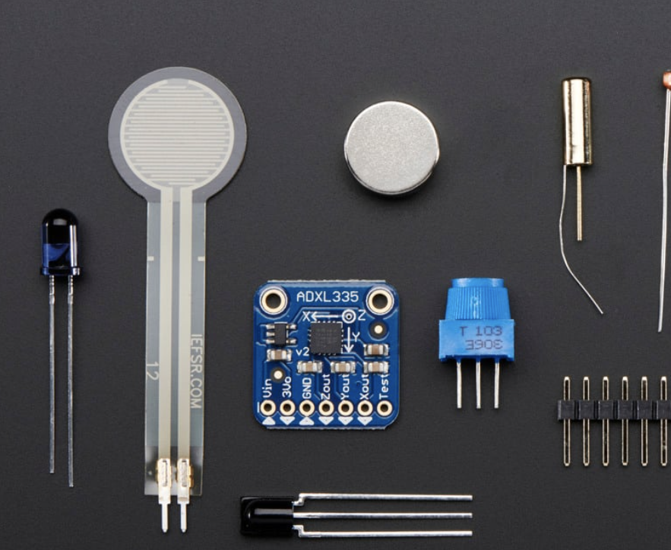
Project Requirements
Internal temperature sensing (for component monitoring)
External temperature sensing
Humidity sensing
Air pressure sensing
6 LED indicators
Multi-axis acceleration sensing
Battery-powered
Data storage

Slide 3
Project Requirements
Less than $147
Less than 200g
Low power consumption (if possible)

Slide 4
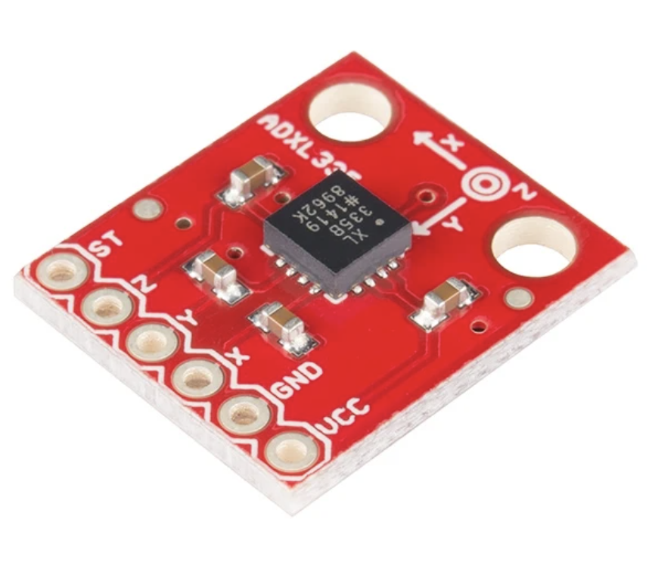
Updated Components: Adafruit ADXL335 (unchanged)
Adafruit ADXL335 Specifications:
3-Axis Accelerometer (0-3G)
Other acceleration ranges available with same footprint and price
~$14.95
~0.945mA operating power consumption
~1.27g

Slide 5
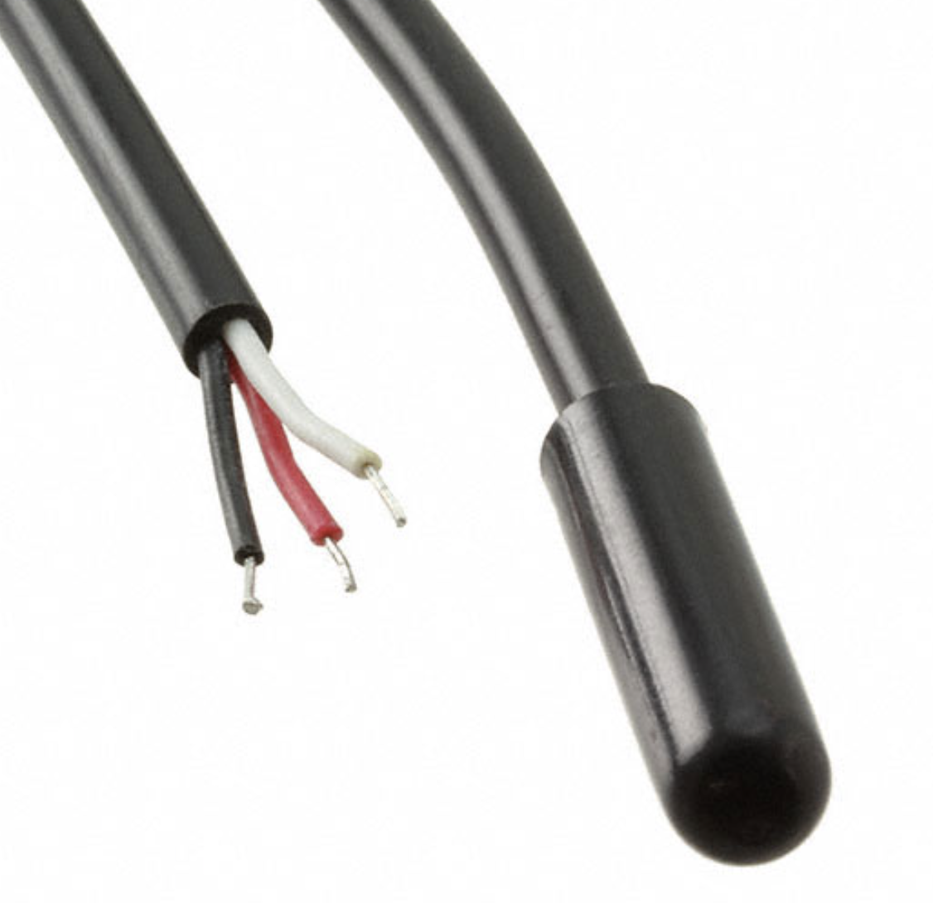
Updated Components: SparkFun 11050 Waterproof Temperature Sensor (external)
SparkFun 11050 Specifications:
Durable external temperature sensor
-55ºC to 125ºC range
~$11.25
~1mA operating power consumption
~8g

Slide 6
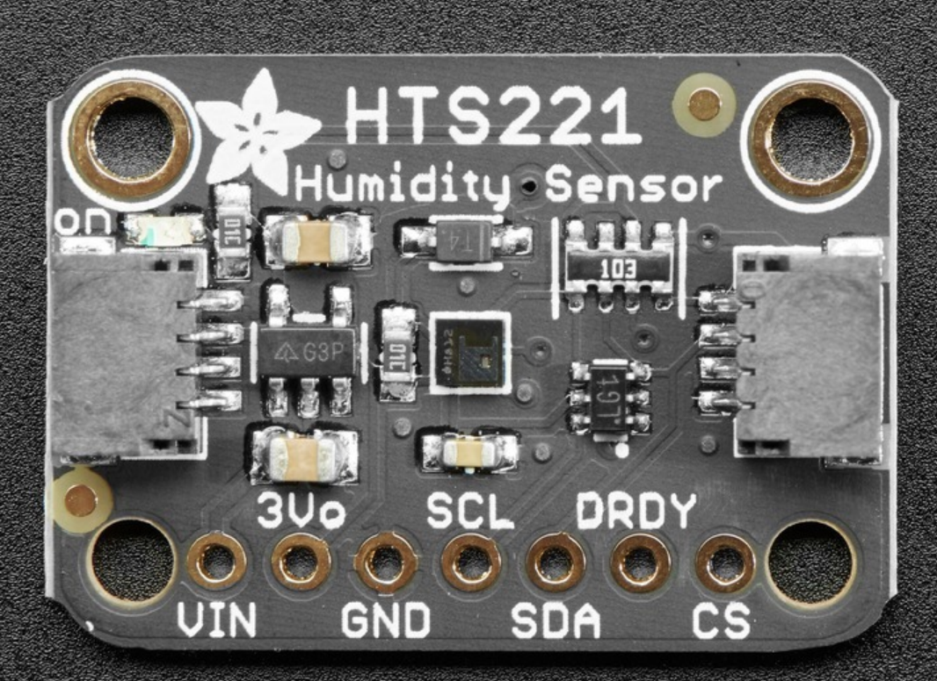
Updated Components: Adafruit HTS221 Humidity + Internal Temperature Sensor
Adafruit HTS221 Specifications:
Combines temperature and humidity monitoring into one device
-40ºC to 120ºC range with 0.5ºC precision
3.5% humidity precision
I2C data transfer implementation available
~$8.91 (when purchasing at least 10)
~0.006mA operating power consumption
~1.4g

Slide 7
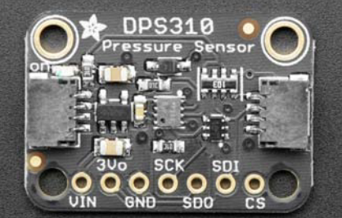
Updated Components: Adafruit 4494 Barometric Pressure Sensor (DSP310)
Adafruit DSP310 Specifications:
I2C implementation available
Up to 0.002 hPa precision
~$6.95
~0.007mA operating power consumption
~1g

Slide 8
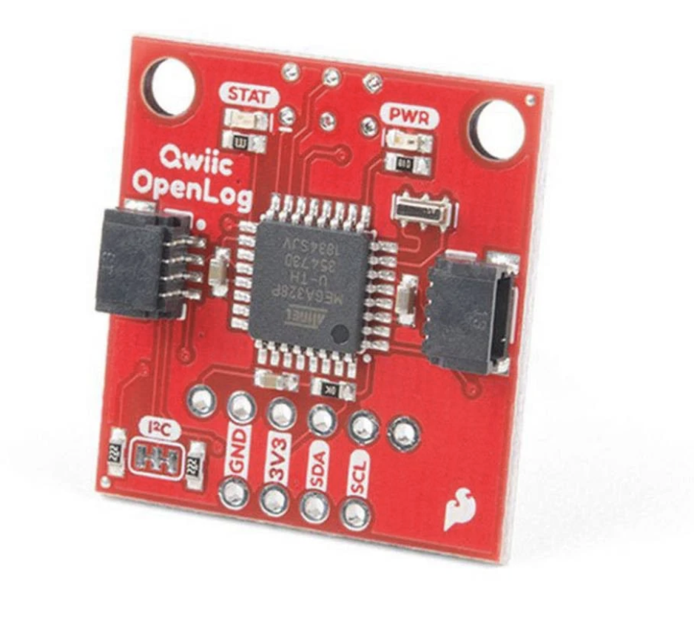
Updated Components: SparkFun Qwiic OpenLog (unchanged)
OpenLog Specifications:
Stores data from microcontroller on microSD card
~$19.95
~15mA operating power consumption
~2g

Slide 9
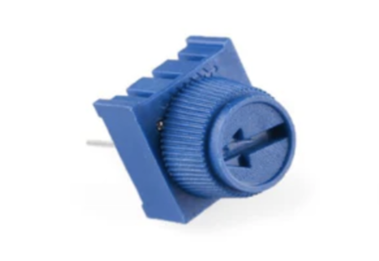
Updated Components: Bourns Inc 3386P-1-103T 10k Potentiometer
Bourns 10k Potentiometer:
Allows for user tuning of system
~$3.07
~power consumption depends on user input
~1g

Slide 10
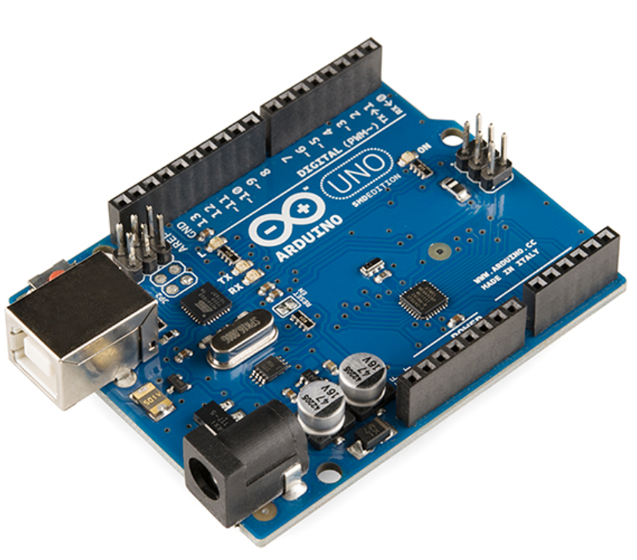
Updated Components: Arduino Uno (unchanged)
Arduino Uno Specifications:
3-Axis Accelerometer (0-3G)
Other acceleration ranges available with same footprint and price
~$27.50
~4000mA operating power consumption
~25g

Slide 11
Sum of Components:
Price: $92.58 + Shipping ($6.99) + Pacific EMS PCB manufacturing (~$20) = $119.57
Weight: ~54.67 g
Power Consumption: ~4.02 W

Slide 12
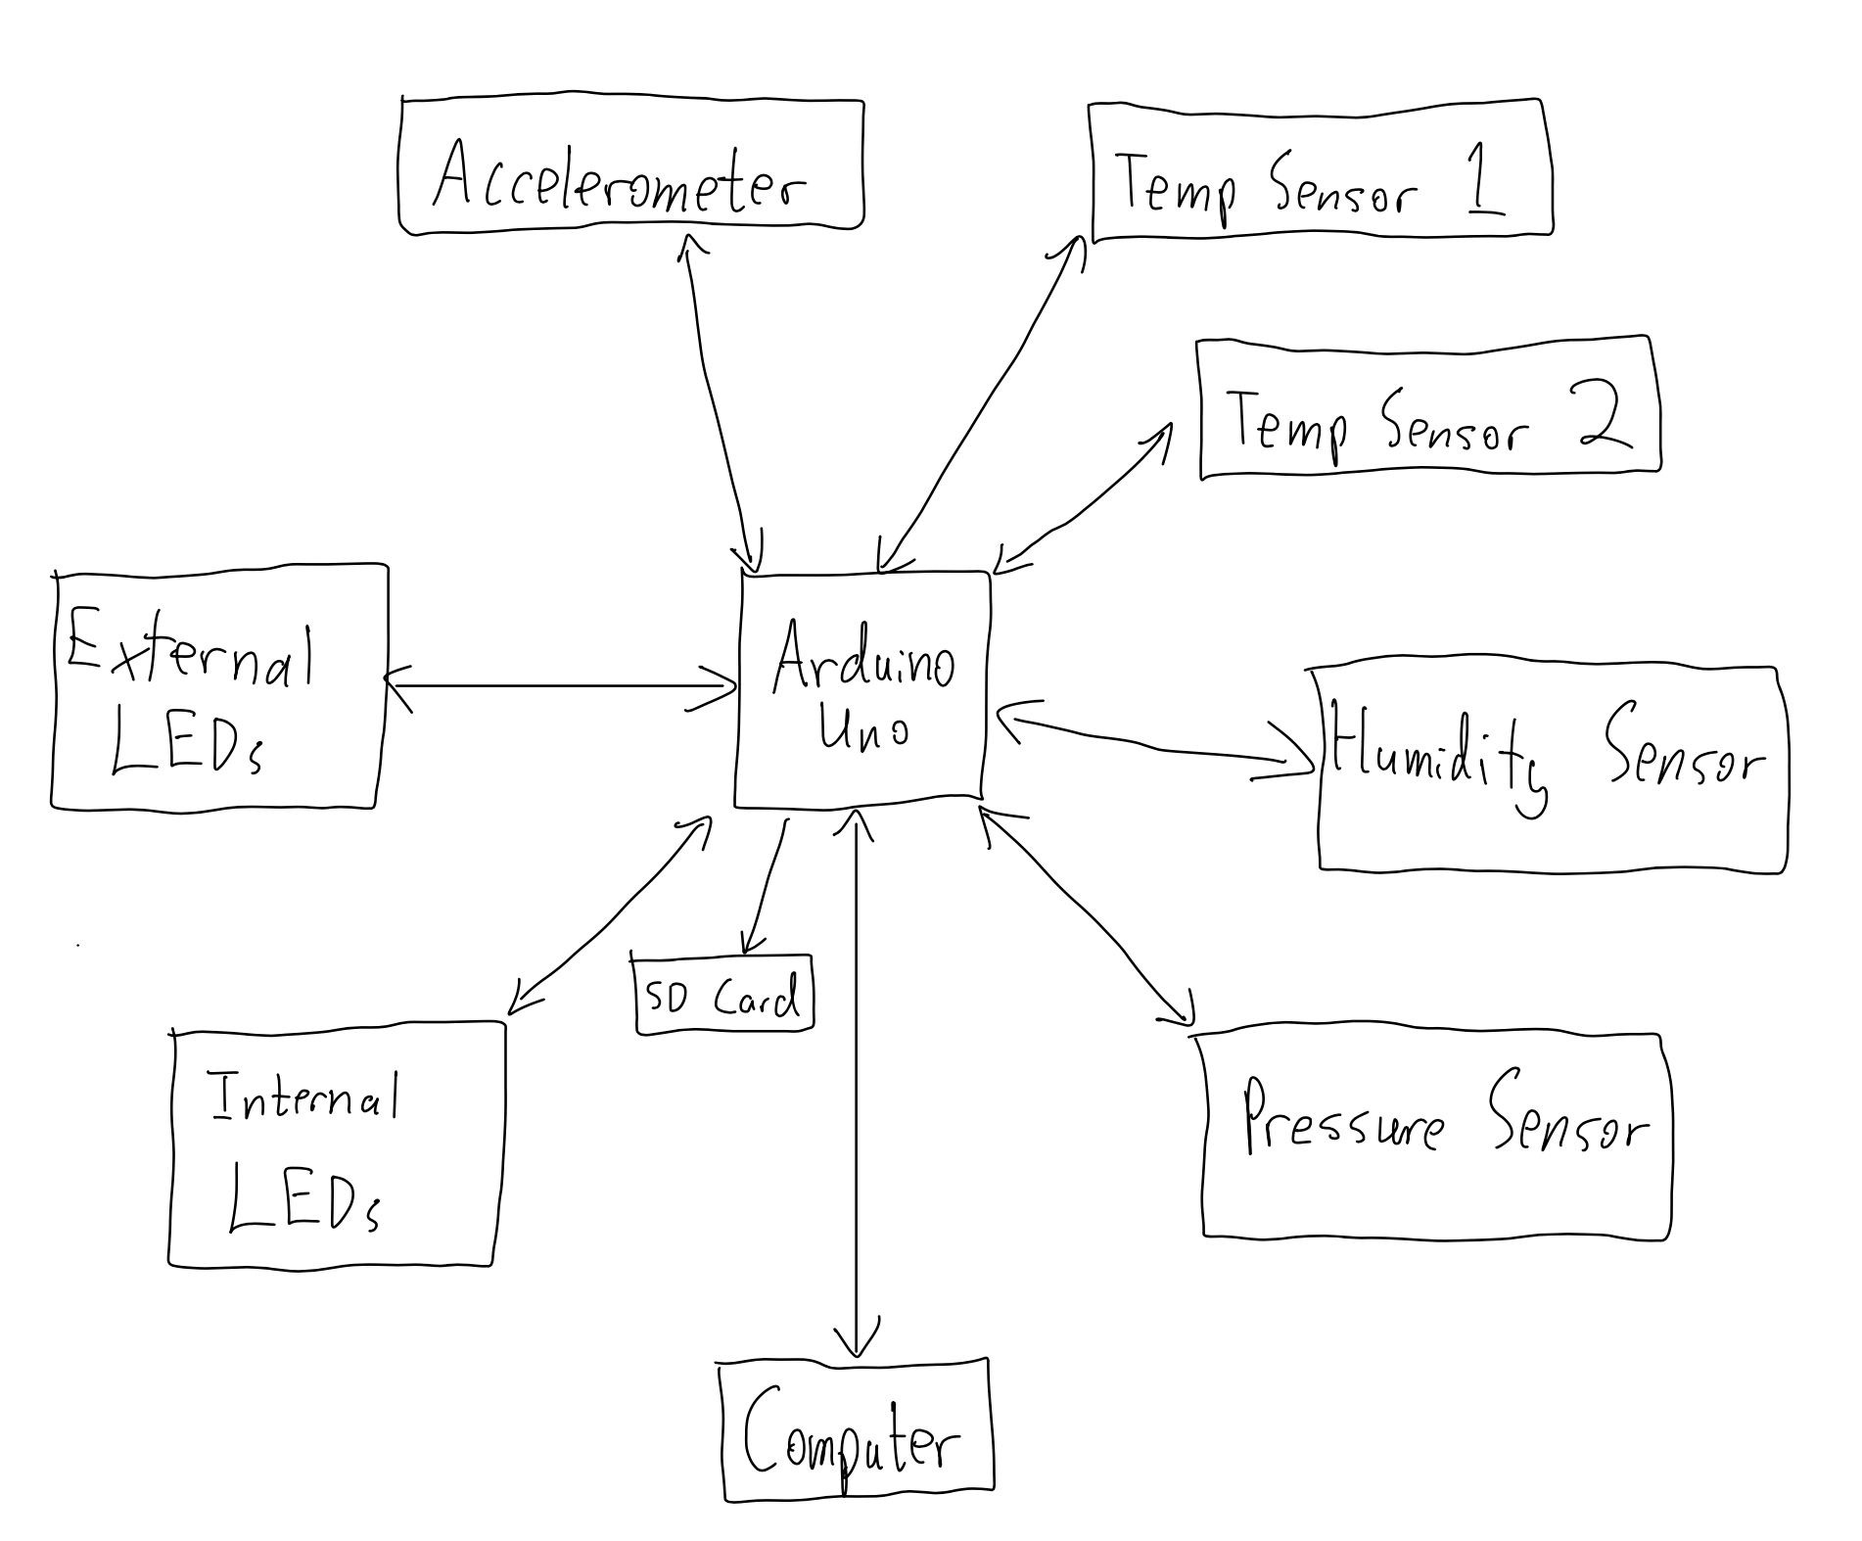
System Block Diagram:

Slide 13
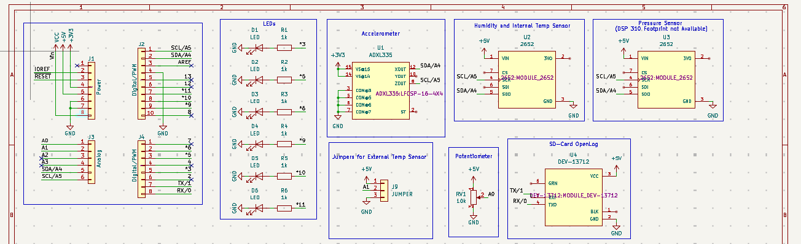
Schematic:

Slide 14
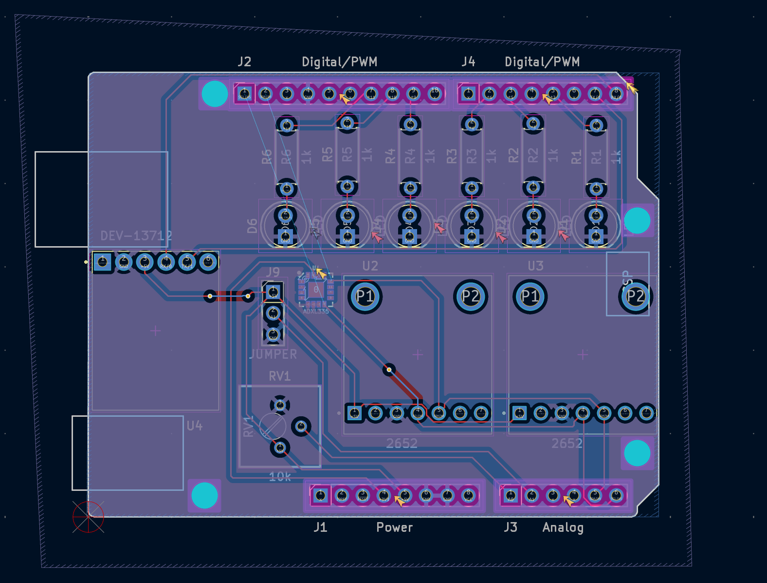
PCB Layout:

Slide 15
Citations:
https://www.digikey.com/en/products/detail/adafruit-industries-llc/163/5353580?gclsrc=aw.ds&gad_source=1&gad_campaignid=20243136172&gbraid=0AAAAADrbLlihOdmDAuf8dQ141Rtil163a&gclid=CjwKCAjwpcTNBhA5EiwAdO1S9qGME7eMpeVcLuNT3RO9lP6GXdeZN5qHc8t9ze1nMbeRT-9XKnBIGxoCA8QQAvD_BwE
https://cdn-learn.adafruit.com/downloads/pdf/adafruit-analog-accelerometer-breakouts.pdf
https://www.digikey.com/en/products/detail/sparkfun-electronics/11050/5721423
https://cdn-learn.adafruit.com/downloads/pdf/adafruit-hts221-temperature-humidity-sensor.pdf
https://mm.digikey.com/Volume0/opasdata/d220001/medias/docus/60/4494_Web.pdf
https://www.digikey.com/en/products/detail/adafruit-industries-llc/4494/11569124
https://vilros.com/products/10k-potentiometer?variant=21355384406116&country=US&currency=USD&utm_medium=product_sync&utm_source=google&utm_content=sag_organic&utm_campaign=sag_organic&srsltid=AfmBOop6qFgeIMUqvxJHiOfE1zMpBU583yQMG74tG8nUrfkeHqJugcrw-r0&com_cvv=8fb3d522dc163aeadb66e08cd7450cbbdddc64c6cf2e8891f6d48747c6d56d2c
https://www.digikey.com/en/products/detail/bourns-inc/3386P-1-103T/2537199

